Slide 1
Eclipse
ADSTOREPOST PPT TEMPLATE

Slide 2
INDEX
Design
·
Art
·
Concept
·
Summary

Slide 3

FOCUS
ADSTORE FREE PPT TEMPLATE
It is during our darkest moments
that we must focus to see the light.

Slide 4
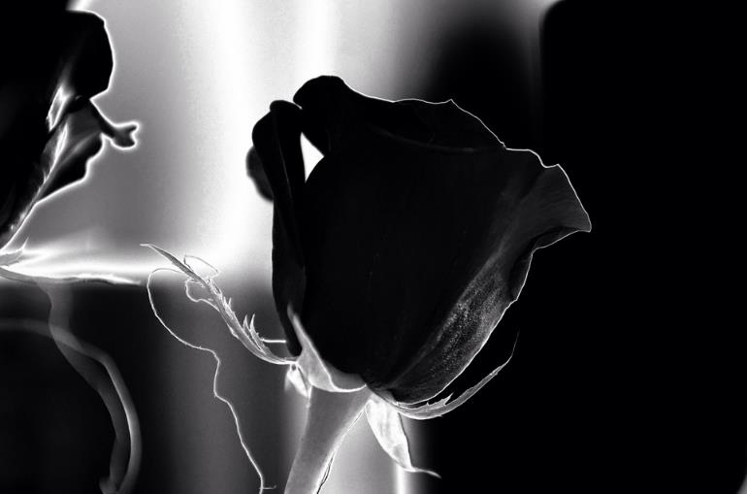
Designed by L@rgo. ADSTORE
ADSTORE FREE PPT TEMPLATE
There is a lot of talk now about metal detectors and gun control. Both are good things. But they are no more a solution than forks and spoons are a solution to world hunger.
Guilt upon the conscience,
like rust upon iron, both defiles and consumes
it, gnawing and creeping into it,
as that does which at last eats out
the very heart and substance of the metal.

